Slide 1
Welcome

Slide 2

OBSTACLE DETECTION AND ALARMING SYSTEM
A Presentation on
Submitted By-
Mr. Ashutosh Shailendra Jarag (24)
Mr. Aditya Kishor Khadake (30)
Mr. Aniket Santosh Mali (34)
Mr. Vinay Vijay Naik (43)

Slide 3
Contents:
Introduction
Problem Statement
DFD
Objective
System Requirements
Future Scope
Conclusion
References

Slide 4
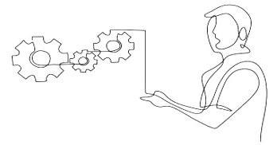
INTRODUCTION
Our IoT-based project, the Obstacle Detection and Alarming System, utilizes sensors to detect obstacles and promptly alerts users with a buzzer alarm. Integrated with a microcontroller for processing and a communication module for remote monitoring, it ensures real-time awareness and safety. With customizable settings and low power consumption, it finds applications in smart homes, industrial safety, and assistive technology, enhancing security and mitigating risks effectively.

Slide 5

PROBLEM STATEMENT
Develop an IoT-based system to detect obstacles in real-time using sensors and alert users through a buzzer alarm. The system should be configurable, energy-efficient, and capable of integration with existing infrastructure for applications in smart homes, industrial safety, and assistive technology.

Slide 6
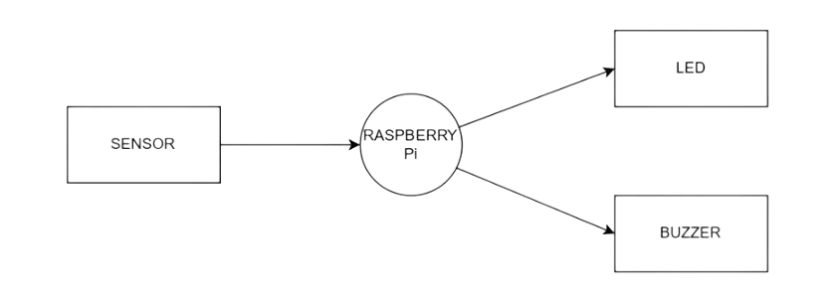
DFD
Level 0

Slide 7
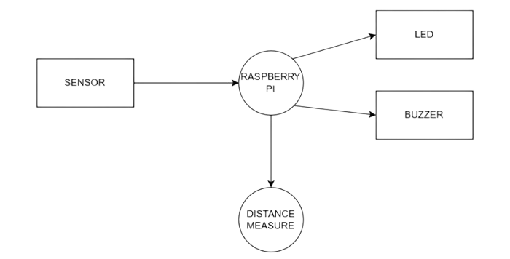
Level 1

Slide 8
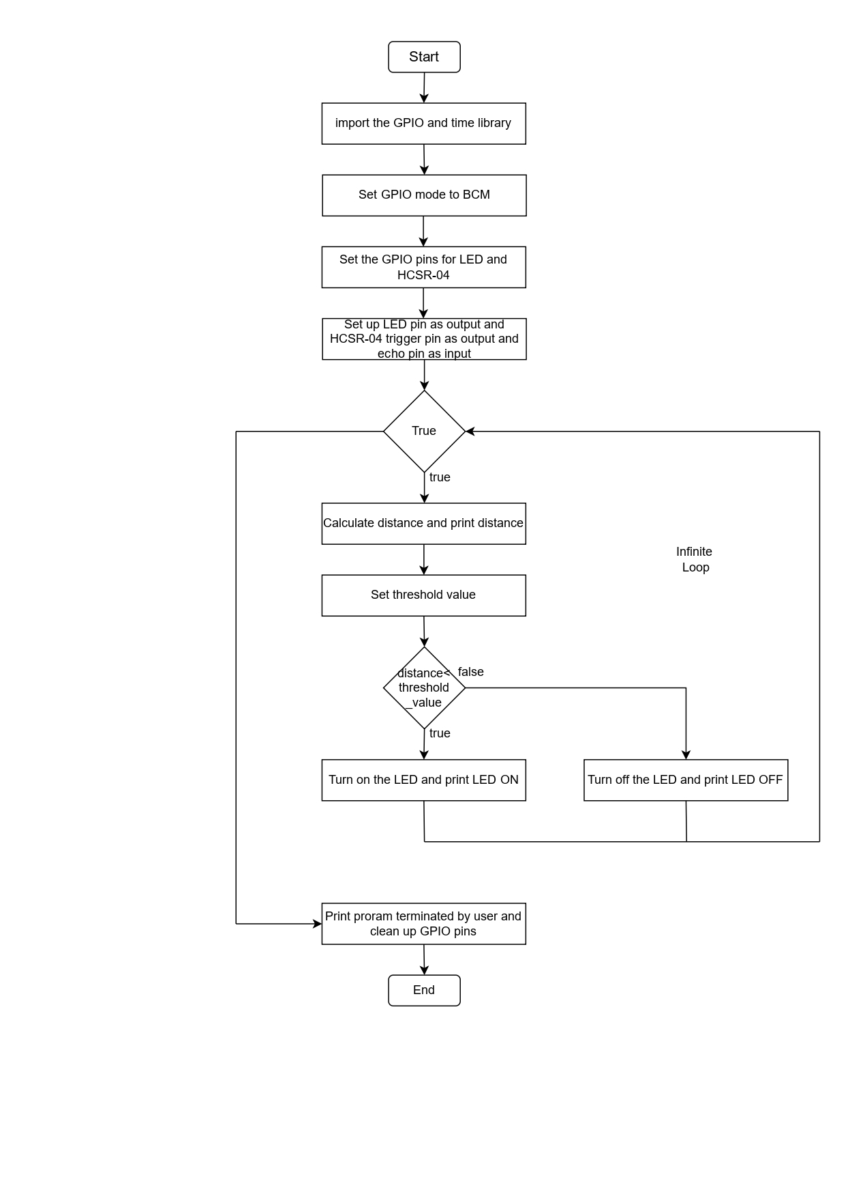
FLOWCHART

Slide 9
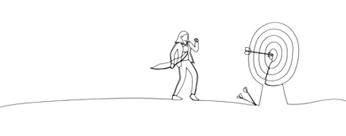
OBJECTIVE
Implement an IoT-based system in vehicles to detect obstacles using sensors and promptly alert drivers with visual and audible warnings. Ensure real-time detection, low power consumption, and seamless integration with vehicle systems to enhance safety and prevent collisions in various driving environments.

Slide 10
SYSTEM REQUIREMENTS
Hardware Requirements:
Raspberry Pi Model 4B
HC-SR04 Ultrasonic Sensor
An Electronic Buzzer
Breadboard and Jumper Cable
Software Requirements:
The Raspbian Operating System
Python Interpreter
An Integrated Development Environment (IDE) like Thonny.

Slide 11
Future Scope
Collision Detection and Emergency Breaking
Retro and Low Budget Car Fitting
Train Collision System
Mirror and Stare Case Light Monitoring System

Slide 12
CONCLUSION
In conclusion, the implementation of the Obstacle Detection and Alarming System in vehicles holds significant potential to revolutionize road safety. By leveraging IoT technology, this system effectively mitigates the risks associated with blind spots and obstacles, offering drivers enhanced situational awareness and reducing the likelihood of accidents. With its real-time detection capabilities and seamless integration into vehicle systems, it not only protects lives but also contributes to a safer and more secure driving experience for all road users.

Slide 13
Thank You

